Slide 1
Health Literacy & NPS MedicineWise
Jemma Gonzalez, Consumer Engagement Lead
Notes:
Thanks Julie for that comprehensive introduction of health literacy and the two key tools that we have used within the audit project.
Good morning everyone (afternoon for our international viewers) and thanks for attending.
I am joining you today from Cammeraigal land on the beautiful North Shore of Sydney.

Slide 2
Health literacy - Audit
Access
Understand
Appraise
Use (act on)
Notes:
I am speaking today about a recent project to assess the health literacy value of NPS MedicineWise consumer education resources.
To build on the results and findings of these three pieces of work, the NPS MedicineWise Consumer Advisory Group recommended a review of currently available NPS MedicineWise web-based resources
to understand:
how our online content helps build health literacy
how easy this content is to understand and act on
ways we can update, add, or remove content to make it more useful.

Slide 3
Health Literacy Audit – working together
Health Literacy Lab
Julie Ayre
Consumers
Helen Belcher
Dianne Smith
John Stubbs
Consumer Advisory Group
Choosing Wisely Advisory Group
Clinical Interventions Advisory Group
Data Governance Committee
Good Medicine Better Health Advisory Group
Mentoring Program Participants
Notes:
I am presenting today on behalf of the project team which includes consumer representatives, NPS MedicineWise and the Sydney Health Literacy Lab who were partners in the project.
This work was funded by the Commonwealth Department of Health

Slide 4
Health Literacy Audit - what we did
1. Map resources
2. Assess resources
3. Review
Recommendations
Map Resources (150)
Identify all consumer content
Mapped against HL indicators
Key statistics
Assess resources (50)
Consumers = PEMAT tool
NPS MedicineWise = SHeLL editor
Review findings
Identify gaps and opportunities
Recommendations for adaptation
Notes:
There were three distinct phases to this Audit:
Gather and map resources: In this phase we identified currently available NPS MedicineWise consumer resources (150 resources) and mapped them to 25 Health Literacy indicators. Web metrics and statistics were also gathered and mapped to the consumer resources.
Refine and assess: We worked with consumers and NPS MedicineWise staff to identify a 50 of the 150 resources for a more in-depth health literacy assessment. We selected these resources based on a variety of reasons, including:
Number of unique page views
Average time on page
Date it was developed
Format
Health literacy gaps
The in-depth assessment involved consumers using the Patient Education Materials Assessment Tool (PEMAT) to assess understandability and actionability, while NPS MedicineWise staff used SHeLL editor to assess readability.
Review and recommend: Present and discuss the results of the in-depth assessments during a series of interactive workshops. 12 consumers (with a broad background of cultures, experiences, and levels of health system interaction) and HLL and NPS MedicineWise staff were involved. The aim of the workshops was to establish recommendations for what content is adapted, created and disinvested.

Slide 5
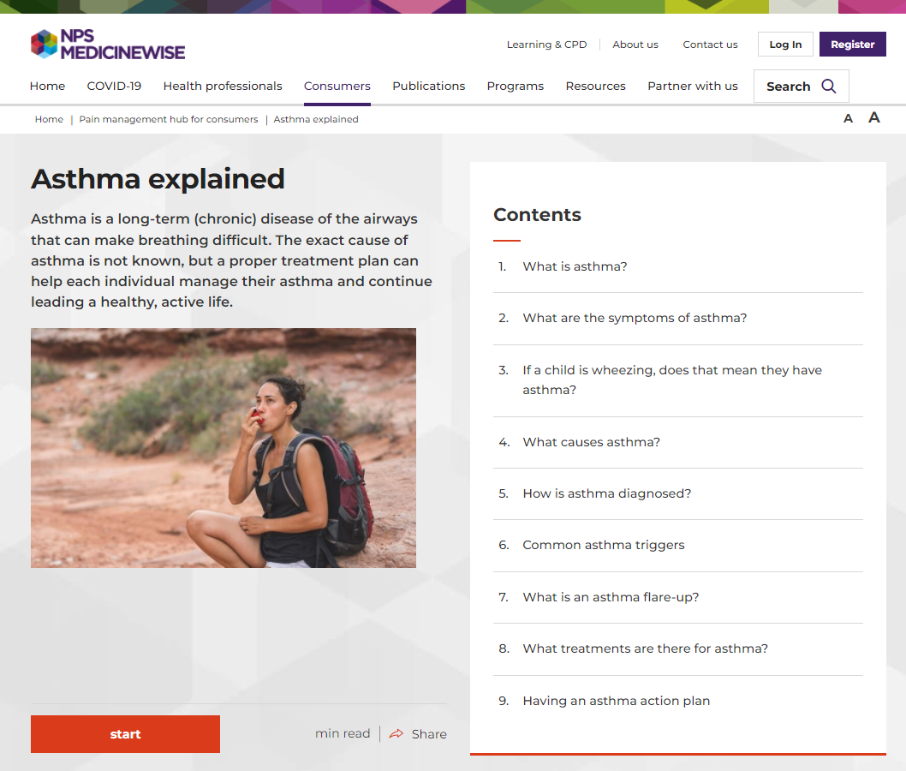
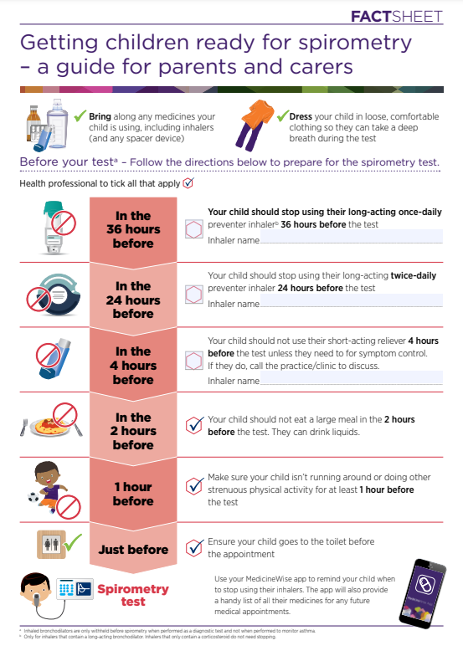
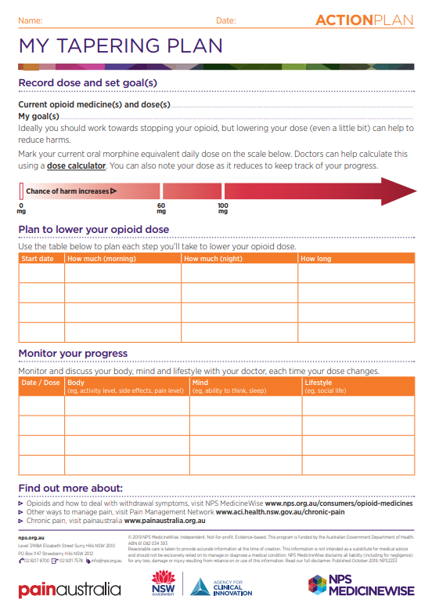
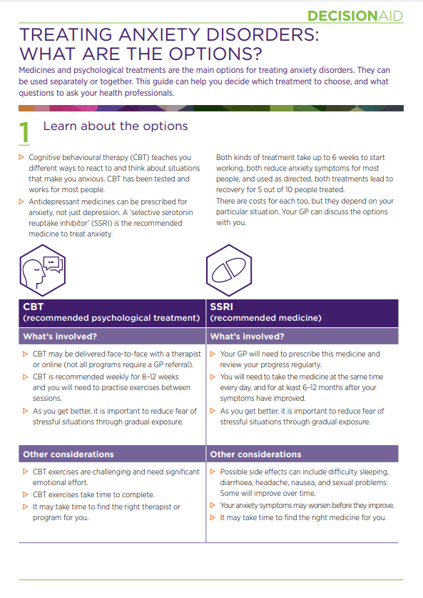
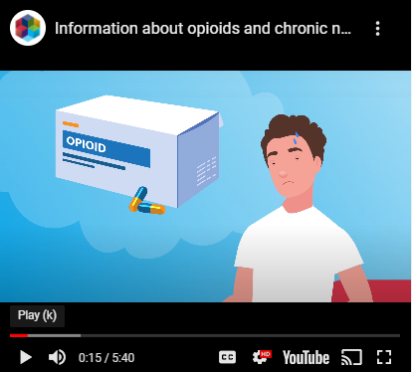
NPS MedicineWise - consumer content
Notes:
Here are some examples of NPS MedicineWise consumer content, so you know what they looks like…
On this slide we have:
Card stacks – which is web content arranged in a series of ‘cards’
Factsheets
Action plans and
Decision aids

